Slide 1
Writing Good Unit Tests
Dr. Matthias Hölzl

Slide 2
Good?
Notes:
Nice to write better test – probably, well, better than writing worse tests
But what does that mean concretely?
Where do unit tests belong in the testing landscape?
What do we want to achieve by writing unit tests?

Slide 3
Two Dimensions for Tests
Tests
Business Focus
Product Critique
Technology Focus
Team Support

Slide 4



Testing Quadrants
Business Focus
Functional Tests Story Tests Simulation Tests Prototypes
User Acceptance Testing Scenarios Exploratory Testing
Unit Tests Component Tests
Performance Tests Security Tests Usability Tests
Support the Team
Critique the product
Technology Focus

Slide 5

Unit Testing: Why?
Tests should improve the quality of our product and enable us to develop with constant velocity

Slide 6
Safety Net
Notes:
Finding mistakes early
Localizing mistakes without long debugging sessions

Slide 7
Maintainability and Extensibility
Notes:
Optimization, change of implementation strategy

Slide 8

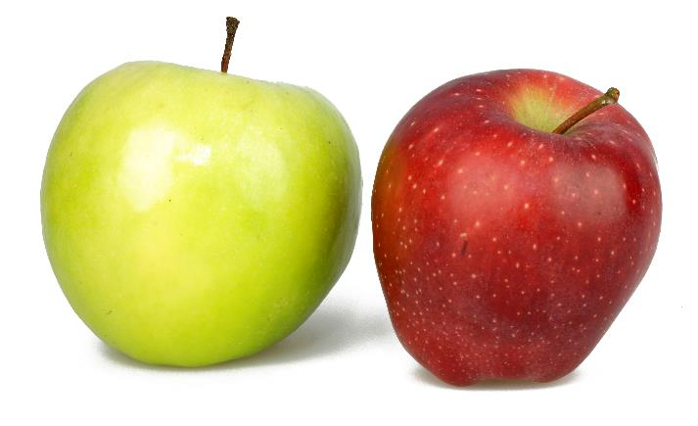



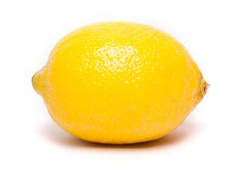
Refactoring

Slide 9

Notes:
Start Simple
Optimize later

Slide 10
Outlook
Notes:
Properties of Unit Tests
Writing unit tests
Writing good unit tests
How many?
Guidelines/rules of thumb
Workshop
Does this work in the real world?
Solving the problems that prevent us from writing good tests in the real world?

Slide 11
Properties of Unit Tests
Notes:
Review of some properties of unit tests

Slide 12

Self-Testing
Notes:
Self testing: fancy name for:
Result is either green (meaning all the tests passed)
Or red (if some tests failed, shows failed tests)
No manual interpretation of test results is necessary

Slide 13
Fast
Notes:
We need to run tests many times a day
Should be quick enough to not interrupt our flow
Not feasible if they take minutes or hours to run

Slide 14
Isolated
Notes:
Each test runs independently of all others
Problems with dependencies between tests:
More difficult to understand the tests
More difficult to locate errors when a test fails

Slide 15
Executable Without Failures
Notes:
All tests execute without failures all the time
No flaky tests that sometimes work and sometimes don’t
No red tests (unless you’re the red phase of a TDD cycle)
Why?
Failing tests mean your test suite is no longer self-testing
Slippery slope

Slide 16
Complete
All parts of the system
Every functionality
Every state
Every equivalence class
All boundary values
Notes:
Otherwise, they don’t provide the guarantees you need to refactor with confidence

Slide 17
Eqiuvalence Classes
Notes:
Equivalence classes are a concept from mathematics
If two objects are equivalent, they can be considered to be the same for some purpose
Even though they need not be identical
For example:
Each group of 12 consecutive keys on a keyboard represents the same notes (just in different octaves)
If we use a RNG to represent coin flips, all odd and all even numbers are equivalent

Slide 18
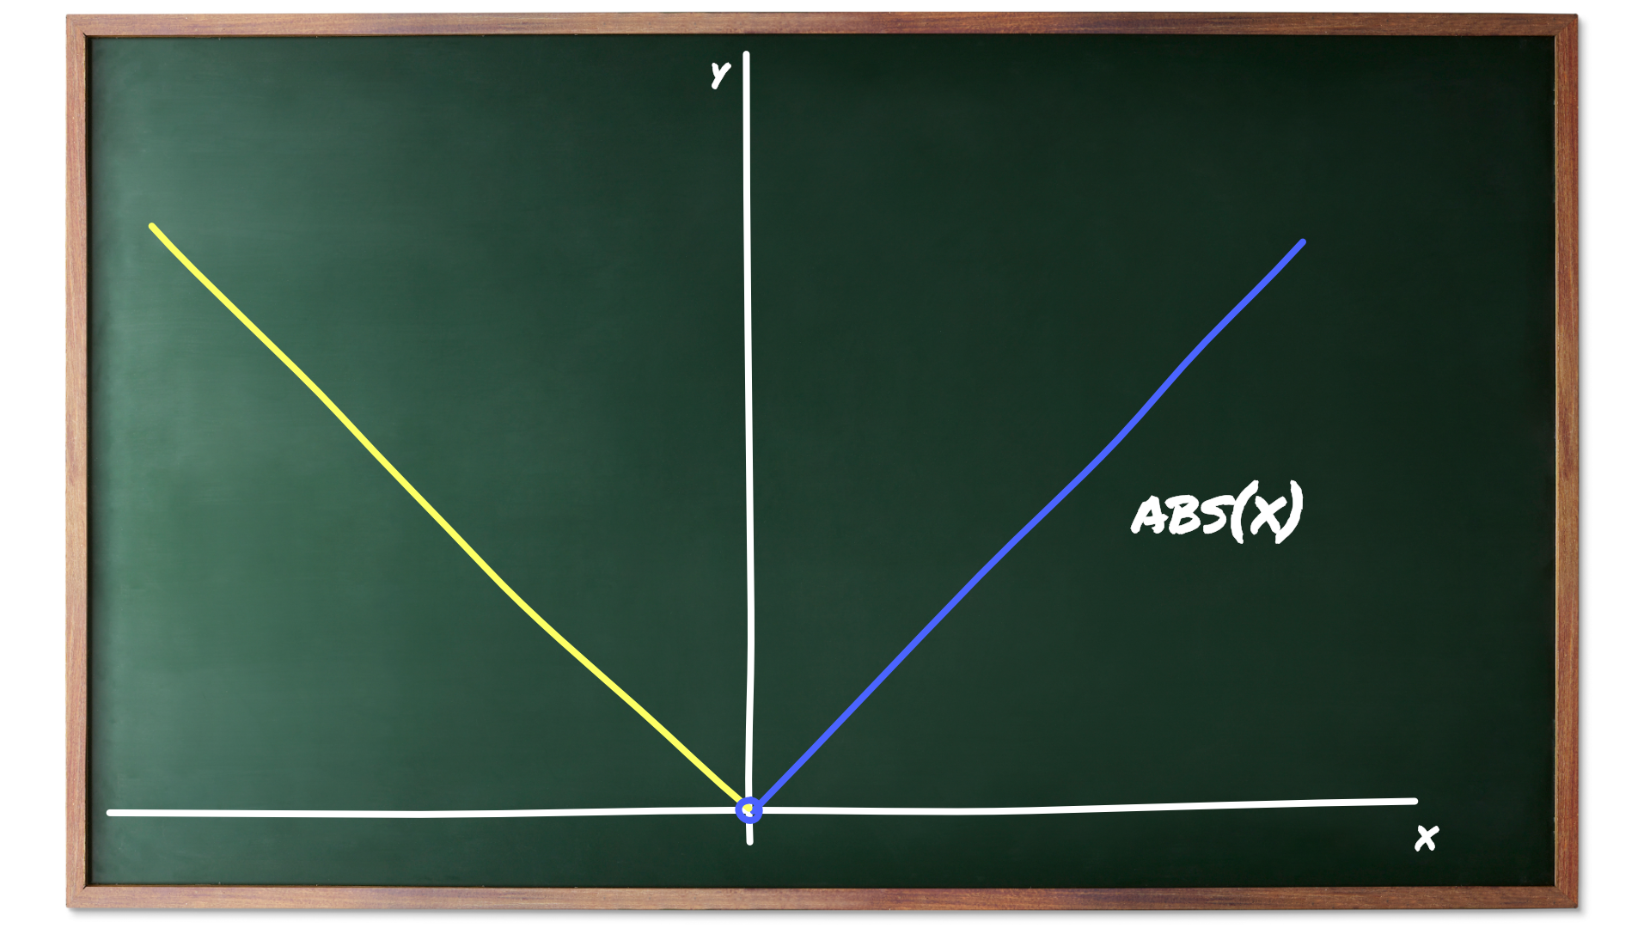
Notes:
To take an example from software development:
The function that computes the absolute value behaves the same for all positive numbers, but differently for positive and negative numbers:
It returns each positive number unchanged but
It negates each negative number
This means we have two equivalence classes:
The positive numbers
The negative numbers
We can assign 0 arbitrarily to one of these classes (or even put it into its own class)

Slide 19
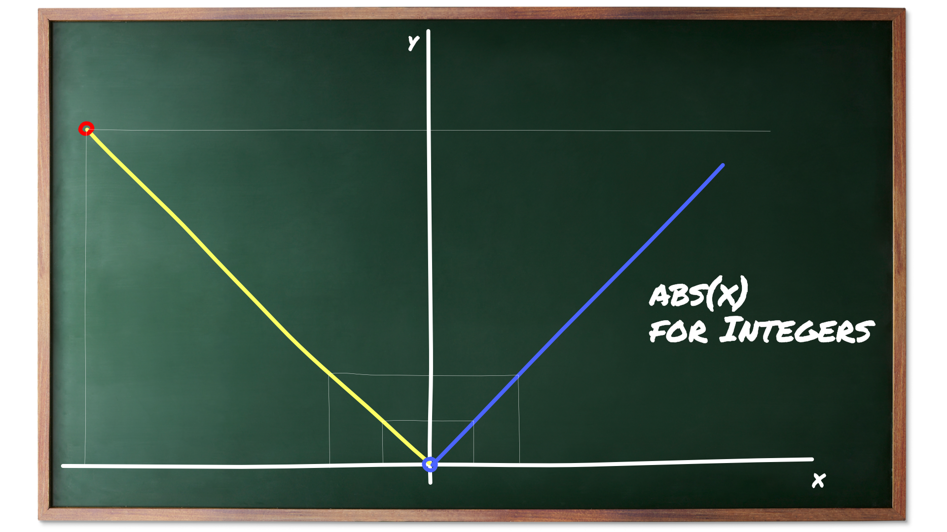
Notes:
If we compute the absolute value for integers things become more interesting:
We still have the two equivalence classes for positive and negative numbers
But now we get an additional equivalence class for the most negative number, since its negation typically cannot be represented
(e.g., 8-bit integers in 2’s complement representation go from -128 to +127)
So the red circle represents the third equivalence class for which the function should signal an error

Slide 20
Boundary Values
Notes:
Sometimes equivalence classes have unique boundary values
Highest and lowest number of integer ranges
When testing it is often useful to examine these boundary values
Because they are most likely to reveal incorrect assumptions or fencepost errors
Before moving on to an example I want to mention another important example of boundary values:
For collections, a common partition is
The empty collection is its own equivalence class
Collections between size 1 and the maximum size form another equivalence class
Collections that are larger than the allowed maximum size are a third class (often this class is empty)

Slide 21
Notes:
Let’s see how testing boundary values for the integer-based absolute value can reveal an error that’s easy to make:
We start testing positive boundary values, everything OK
When testing the -1, still everything OK
When testing the most negative number things go wrong
Fix this, test again with most negative number + 1

Slide 22


Slide 23

Writing Unit Tests

Slide 24
Format of a Unit Test
Arrange
Act
Assert
Given
When
Then
TEST(MySubsystem, Output_WhenScreenIsDefaultSize)
{
Screen unit{80, 25};
std::string text{“Example Output”};
unit.writeText(text);
ASSERT_THAT(unit.getText(), Eq(text));
}
Notes:
Test framework takes case of self testing
Each test should test a single concept (some people say a single assertion per test)

Slide 25

Ideal vs. Reality
What your test should look like:
What tests often look like:
Arrange
Act
Assert something very complicated
Arrange
Arrange some more
Arrange
Do some more acting
Act inconspicuously
Assert something even more complicated
Assert something with no connection to anything else
Continue arranging some stuff
We’re not nearly done arranging
Nope, still arranging
We are being really assertive here
Can’t assert enough
Don’t even think about stopping here
There’s so much to arrange
Is this the end?
Nope, still more stuff to arrange
Act like you don’t care
Assert something that no mere mortal can comprehend
Assert some important truth about the universe
Assert that you don’t like writing unit tests
Assert the end of the assertions
Arrange something that you need for the next few actions
Step one of some complicated sequence
Arrange some more state
Step two of the complicated sequence
Can’t resist one final act
Arrange
Act
Assert

Slide 26
Expressive unit tests can serve as documentation by example

Slide 27
Writing Good Unit Tests

Slide 28
Exhaustive Unit Testing

Slide 29
Why not?
Example: Password entry
Passwords with max 20 characters
80 possible characters (A-Z, a-z, 0-9, !@#$%...)
80²⁰ = 115.292.150.460.684.697.600.000.000.000.000.000.000 Inputs
If each test takes 10ns it would take 10²⁴ years to test all inputs
The universe is ~ 1.4 x 10¹⁰ Years old

Slide 30
Effective Unit Testing
Notes:
Unit tests must be effective and efficient
Effective: Find as many mistakes as possible (ideally: all of them)
Efficiency: Use as few and as simple tests as possible to achieve this

Slide 31
Efficient Unit Testing
Notes:
Unit tests must be effective and efficient
Effective: Find as many mistakes as possible (ideally: all of them)
Efficiency: Use as few and as simple tests as possible to achieve this
Example: Control Flow based testing
- The CFG is a graph that represents the control structure of a program

Slide 32
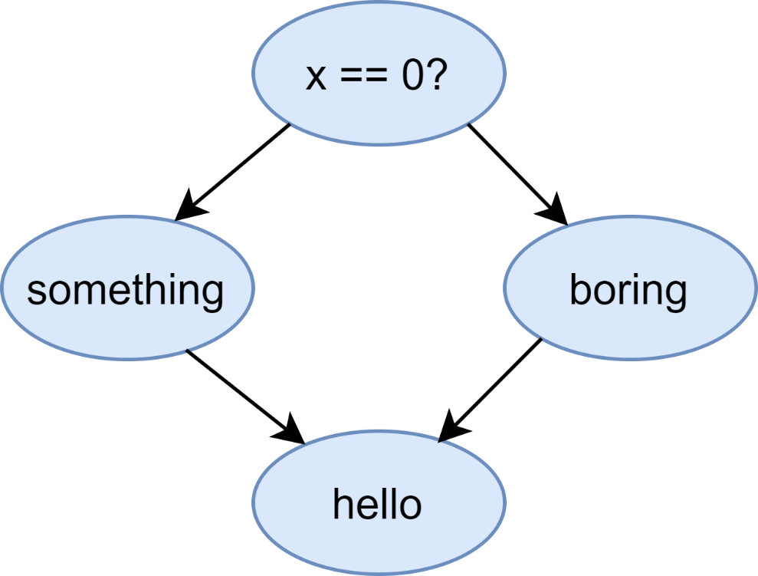
CFG-Based Testing
if (x == 0) { print "x == 0“ print "This is interesting.“ } else { print "x != 0“ print "The boring case.“ } print "Hello, world!"
Notes:
Statement Coverage:
The percentage of program statements (nodes in the CFG) covered by tests
Branch Coverage, Decision Coverage
Percentage of edges in the CFG covered by tests
100% branch coverage implies 100% statement coverage, but not vice versa

Slide 33
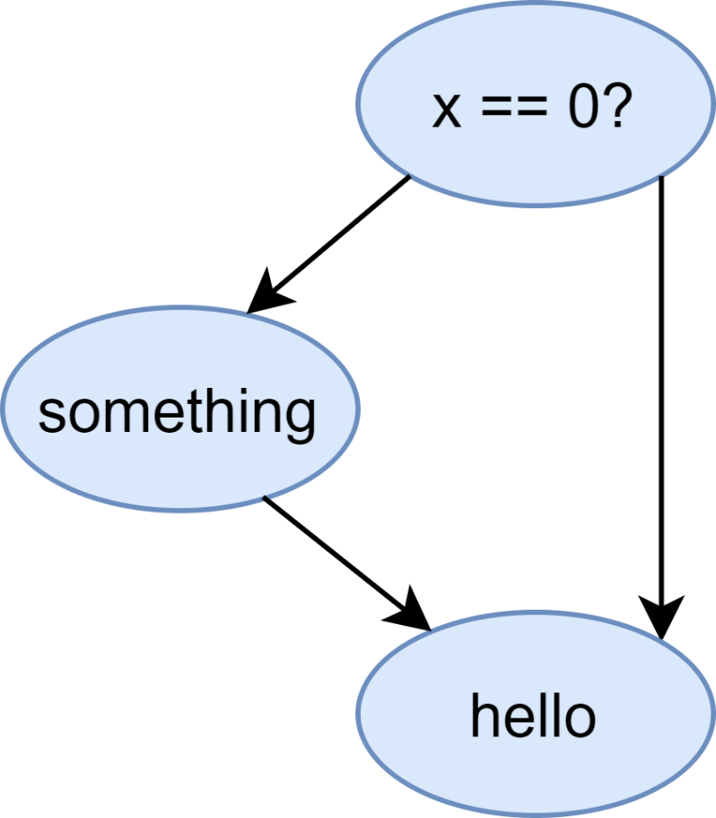
CFG-Based Testing
if (x == 0) { print "x == 0“ print "This is interesting.“ } print "Hello, world!"
Notes:
Statement Coverage:
The percentage of program statements (nodes in the CFG) covered by tests
Branch Coverage, Decision Coverage
Percentage of edges in the CFG covered by tests
100% branch coverage implies 100% statement coverage, but not vice versa

Slide 34
Rules Of Thumb

Slide 35
Functionality, Not Implementation
Notes:
Abstract away implementation details
Yes, even on the unit level
You may have to introduce methods that allow this
E.g. inspect “abstract state” instead of concrete one
Look at algebraic datatypes for examples how this is done
Why?
Easier to understand
Functionality is more stable than implementation
Functionality is closer related to customer/programmer value

Slide 36
Results > State > Behavior
Notes:
Why?
Easier to understand
Easier to test
Better isolated against refactorings
Exception
Testing (network) protocols
Acceptance Tests
Controllability
Observability
Smallness

Slide 37
Results, State, Behavior
int Add1(int i);
class Adder {
public:
void SetInput(int i);
void Compute();
int GetResult();
}
class BehavioralAdder {
public:
void CallAdder(int i) {
a.SetInput(i);
a.Compute();
}
private:
Adder a;
}

Slide 38
Observability
Notes:
Without observability you can’t write tests
Design your interfaces so that the “abstract state” is observable
This does not mean exposing implementation details or writing getters/setters for everything
(Typically interfaces that are not observable are also difficult to use)
If you need to have objects that are not observable, make sure they are easy to replace/stub/mock in tests (i.e., provide seams)

Slide 39
Controllability
Notes:
You cannot test a system that you cannot bring into a desired state.
It is often useful to have systems that expose parts of their “wiring” to the outside (e.g., dependency injection)
There are many specific techniques for testing systems which are only partially controllable (e.g., state machines), but it’s easier to not have to use them.
Transition tours: Generate a sequence of events that starts at the initial state, reaches each state at least once, and returns to the same state.
TTs are easy to find, if they exist
TTs generate short test cases
Can discover errors in activities/outputs, but not errors in transitions
Distinguishing Sequence:
Series of events that generates a different set of activities/outputs for each state
Use DSs to discover bad transitions
For each transition: start the DS from this state; if the output deviates from the expected output there is a bad transition
Need to be tried systematically
May not exist
Computation of DS is very complex (exponential)
Good to verify whether a state machine conforms to a protocol
Some states cannot be reached (e.g., assertions); this can be a problem for coverage tools if high coverage is desired.

Slide 40
Identify Seams

Slide 41
Small is Beautiful
Notes:
Why?
Better specification of unit behavior
Simplify localization of errors
Are easier to maintain

Slide 42
Notes:
Use test doubles if and only if the real dependency launches a missile
Test doubles: Stubs, Fakes, Spies, Mocks
Replace a dependency with a simplified version
Important to simplify unit tests and make them fast and reliable
But: too many or complex test doubles make tests hard to read, maintain
What does this test actually test?
Typical uses:
Classes that access the environment (data base, file system, …)
Time, dates, random numbers
Eliminating non-determinism

Slide 43

Your code has to allow this style of testing

